Slide 1
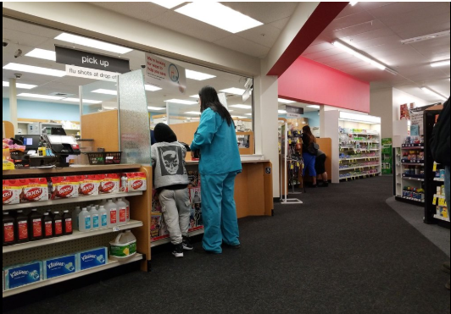



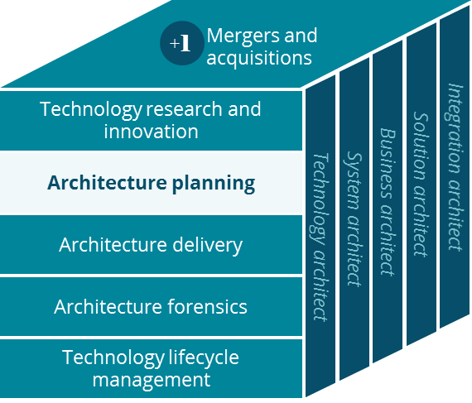

Clinical Platform (Version 3.2)
Architecture Planning
David Fitzgerald
July 2019

Slide 2
Table of Contents
Slide Title | Intent
Executive Summary | Provides summary of deck’s key contents
Background / Opportunity | Describes the problem or opportunity CVS is currently facing that has led the O-CTO to develop this North Star.
Why is it Important to CVS | Drives alignment with business, either through showing how their current mission is aligned with the North Star.
Strategic and Future Thoughts | Lays out the potential actions that, if taken, could result in full realization of the North Star to the end.
Next Steps / Roadmap | Allows the O-CTO to provide recommendations on how to move forward with the necessary action(s). This is possibly “where to start”, “what to do” – this is not the full set of actions to get to the end-state.
Platform strategies are an approach to delivering business capabilities that drive down costs, accelerate transformation and improve consumer experience. Platforms combine business and IT capabilities to create a unified landscape of modular components with clearly defined roles and responsibilities. Each platform is developed and operated as an independent entity, with well-defined relationships to other internal and external platforms.
A full-fledged platform brings together business processes and IT systems in a first-class integrated fashion. Each platform can and will have multiple different underlying IT systems, each fulfilling their part of the overall platform capabilities.
Platform strategies are owned and executed by a business owner and an IT owner, who take end-to-end responsibility for providing the associated platform and operating it like a service, through a cross functional platform delivery team. Governance and decision processes are aligned to maximizing enterprise value while maintaining decision agility and delivery speed.

Slide 3


Executive Summary
Platform strategies are an approach to delivering business capabilities that drive down costs, accelerate transformation and improve consumer experience. Platforms combine business and IT capabilities to create a unified landscape of modular components with clearly defined roles and responsibilities.
Opportunity
Conclusions
Recommendations
There are duplicated clinical systems across the enterprise: over 10 Care Management/UM systems across the enterprise. 2 Member Incentive systems, 2 Population Health solutions, several customer engagement systems, etc
Business owners across the enterprise are frustrated in selecting clinical solutions for their business.
There are many conflicting clinical data integration methodologies and systems
There are synergistic opportunities between pharmacy, clinic and care management.
CVS’ acquisition of Aetna is creating an opportunity for CVS to truly impact the USA healthcare industry, CVS can “lead the change” in the US healthcare economy.
Duplicate clinical systems and ownerships of clinical systems create waste and inconsistencies in programs
Varied technology stacks and processes are creating difficulties in synergy efforts.
Amplify the existing Clinical Platform initiatives to serve all of CVS Health. Providing better clinical results, greater continuity of information and improved costs/savings.
Assign/Assume joint business and technical overall clinical capability leadership/ownership
Communicate clinical capability leadership ownership.
Notes:
Platform: (McKinsey) : Platforms focus on business solutions to serve clients (internal or external). They operate as independent entities that bring together business, technology, governance, processes, and people management and are empowered to move quickly.
Platform: (Wikipedia) : A platform is a business model that creates value by facilitating exchanges between two or more interdependent groups.
The theme: Consistency of Programs, customer messages/experience and overall CVS cost of ownership – are critical factors….. .
Business owners across our enterprise are trying to run their business the best way they know. Many have full autonomy to make enterprise independent decisions - whatever is best for their business. Some business owners are now seeing the cost in those independent decisions via - duplicated programs, analysis, systems and platforms causing much, much higher costs of integration, analysis and maintenance.

Slide 4

Business Opportunity
A full-fledged platform brings together business processes and IT systems in a first-class integrated fashion. Each platform can and will have multiple different underlying IT systems, each fulfilling their part of the overall platform capabilities.
Opportunity Statement
Overview
There are duplicated clinical systems across the enterprise: over 10 Care Management/UM systems across the enterprise. 2 Member Incentive systems, 3 Population Health solutions, several customer engagement systems, etc
Business owners across the enterprise are frustrated in selecting clinical solutions for their business.
There are many conflicting clinical data integration methodologies and systems
Notes:
Next 2 slides for different perspectives
The theme: Consistency of Programs, customer messages/experience and overall CVS cost of ownership.

Slide 5
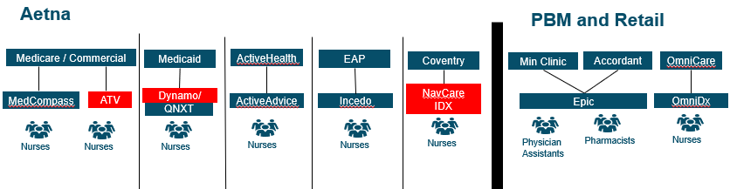
Lines of Business Care Model
Notes:
2 instances of Epic

Slide 6

Even today some of our data feeds are created “as needed” from one source to another, thereby creating duplication, inefficiencies and lacks source of truth
Clinical Data Sharing Current State View
MedCompass
Care Everywhere
Cerner EMR
DataLink
UDF
CareUnify
Availity
MinuteClinic (Epic)
Separate EMR Business Requests (UM, Medicaid, Risk Mgt, NQM, Med Cost Mgt)
Accordant (Epic)
Notes:
We need strong and possibly patient leadership to express doing “things right” the first time, rather than doing things fast and inefficient.
The theme: Consistency of Programs, customer messages/experience and overall CVS cost of ownership.

Slide 7
Why is it important to CVS Health?
Stated CVS initiatives are to reduce healthcare costs
What CVS Health could gain…
Potential Benefit
Description
Positive Outcomes
Costs Savings : technical, analytical, vendor, hardware etc.
Synergistic Savings
Better customer/patient/ member care and experience.
Prior to the CVS purchase of Aetna, Aetna had redundant clinical systems. Post acquisition, there are more overlaps of systems, people and capabilities.
As we synergize and share data not only will cost of overall systems go down but medical cost could be reduce by enabling clinical insights and data visibility to be passed to those who need it to help our customers
As data flows more freely across the health continuum, greater clinical awareness is spread as well.
Significant costs savings across many areas of business, systems and integrations
Reduced medical cost and complexity not only within CVS but to our customers including not only the patients but also our providers.
Created a better “connected” experience for all those engaging CVS.
Notes:
The theme: Consistency of Programs, customer messages/experience and overall CVS cost of ownership. Simplifying our footprint will make it easier for CVS to adopt and serve our customers better

Slide 8






Why is it important to CVS Health?
Creating unmatched human connections to transform the health care experience
Our Strategic Imperatives
Start with the consumer …
… to transform our business and industry.
Be local
Engage people with the care they need where they need it
Lead the change
Challenge the status quo with new technologies, business models and partnerships
Attract and inspire
Unlock the power of our people to transform health care
Optimize performance and service
Ensure our people, processes and technology enable our strategy
Make it simple
Make a complicated system easier for all
Improve health
Help people achieve better health at a lower cost
Personalized face to face interactions, through: Community Care, Health-Hub, Minute Clinic and the Pharmacy will continue to drive the localization strategy with the Clinical Platform
The Clinical Platform will seamlessly bring together all of the CVSH clinical interactions and content.
Driving our customers health journey by deeply integrating with our insights and being proactive in our conversations will drive positive health outcomes.
The Clinical Platform enables us to innovate aggressively by providing foundational elements as part of the platform, enabling businesses to invest in differentiators.
Providing clinicians with personalized insights (Alerts, CCs, Gaps etc) will help our customers health journey; will lead the Healthcare industry
A unified Clinical platform will centralize operations improve productivity, remove inconsistencies and redundancies while accelerating innovations.
How We Differentiate
Notes:
How does Clinical map to the overall CVS Strategy?
The theme: The theme: Consistency of Programs, customer messages/experience and overall CVS cost of ownership.

Slide 9

Clinical Platform Strategy – Strategic Programs
Strategic, investments are transforming the Business Operating Platforms
Clinical Impacts
Major Ongoing Programs
Engagement
1
2
Digital Consumer Experience*
(Apps, Shopping, Health Cloud)
Local Consumer Experience*
(Stores, Minute Clinics, Pharmacies)
Other Constituent Experience*
(Plan Sponsor, Broker, Provider)
1
CVSH Digital activities
Apple Partnership
Pop Health VBC
Medicare NextGen
ElevateCare
Guided Personal Service
Clinical Platform
10+ PA Systems
Epic
Financial Data Repository
2
Account for Life
Global ID
Next Gen
Authentication
Ecosystem Platform
Preferences
360 Profile
Omni-Channel Interaction
Transactional
3
Benefit Admin Model
Care Model
9
3
Service Model
7
Retail Model
4
Provider and Network Platform*
PBM
Product
&
Pricing
&
Claims
& Actuarial*
5
Service Platform*
Clinical & Logistics Platform*
6
Point-of-Sale Platform
5
4
Medical
Prior Authorization Platform
8
Call Center Platform*
Supply Chain Management
Specialty
6
Retail Pharmacy Platform
6
7
Insights
8
Reporting & Business Performance
Actionable Insights*
10
Unified Data Fabric*
9
10
* = Major joint transformation opportunity
Notes:
CVS Landscape
The theme: Consistency of Programs, customer messages/experience and overall CVS cost of ownership.

Slide 10
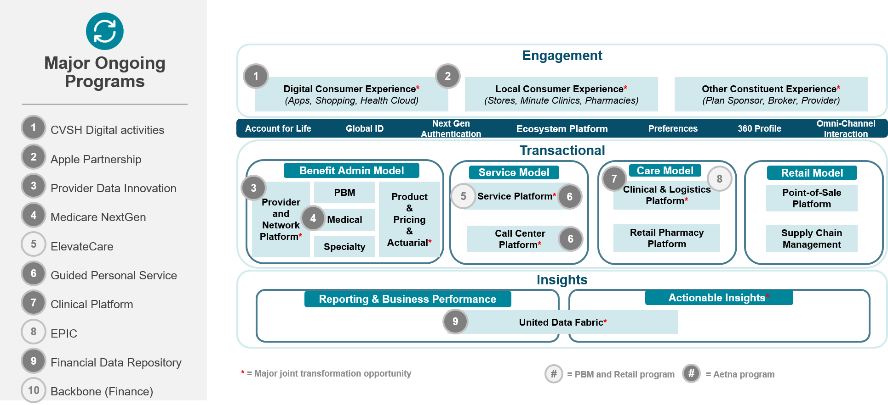
IT Strategy: Business Platforms
Harmonizing and integrating lowers cost and accelerates transformation
Harmonize capabilities (think which platform does what)
Rationalize duplicates (think Clinical platform and GPS) and purposely synergize.
Deeply integrate adjacent capabilities (think EPIC and MedCompass)
Enhancing our technological capabilities
The Case
for Change
1
An “open source model” is a required platform characteristic, business-wise and IT-wise
Enable flexible business models and 3rd party integration (think Plug and Play)
2
Business unit accountability, enterprise responsibility
Platform thinking, roadmap and investments (think Apple, Google, Amazon, Facebook, Disney, …)
3
Notes:
Why do we want Business Platforms?

Slide 11
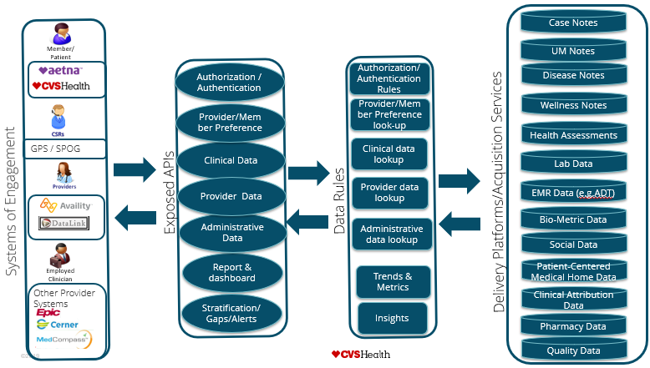
What does Success look like?
In an ideal future state, CVS would provide its Members, Clinicians and Providers with a full suite of engagement options to enable a healthier life.
NOTES:
Enable an organization wide Clinical Platform, whose mission and vision is:
Create a platform to host any and all Clinical applications and data.
Accept data from a known divergent pool of suppliers defined by the business
Expose data to known consumers.
Enable an architecture to Plug-and Play at the speed of business – to either add or remove suppliers, consumers, applications or partners
Need: Possible Individual consent of data passage.
Need: Delete data on demand
Need: Privacy by design
Clinical Platform and UDF
Note: APIs Are Application Interfaces, which can include EDI interfaces

Slide 12
Future State Clinical Platform
Integrate Epic, MedCompass, DataLink(CareBook), RxConnect and Availity to create a unified care journey
Insurance (Aetna) investing in MedCompass – migrating many clinical systems to one platform
Clinic and Retail investing in Epic – clinical function pockets in other systems (RxConnect)
Provider Contracting investing in DataLink(CareBook) for Value-Base contracting
Clinical Platform
Clinicians
Nurses
CMO
Data Analysts
Outreach Teams
Physician Assistants
Pharmacists
Network
Physicians
Case
Management
Utilization Management
Disease
Management
Wellness Management
Incentive
Management
Population
Health
Clinic
MTM
Fulfillment
MedCompass
DataLink (CareBook)
Epic
RxConnect
UDF
(Clinical Info and data)
Quality Management

Slide 13
Next Steps
Connect everything – Manage Everything – Change the Mindset
Recommendations
Immediate
Mid-Term
Long-Term
Agree to the Vision to support a Clinical Platform
Define and communicate executive ownership of key business capabilities like: Case Management, Disease Management, Wellness Management, Population Health, Pharmacy Fulfillment, and Clinics
Create Operational, real-time data exchange within the Platform and Cached data for usage outside of the Platform (UDF)
Create a shared common Clinical Platform serving all of CVS Health
Deliver consistent clinical information across all experience channels (internal and external)
Honor user preferences in all our interactions, where appropriate
Deliver timely, personalized clinical experiences
Help our customers “connect” to clinical content (IoT, monitors, devices)
Make Rx and medical authorizations easy to submit and create visibility into the status.
Notes:
See the Clinical Manifesto

Slide 15
Prioritized Business Use Cases
Magnifying Glass – Please!
The high-level Integration impacts,
A view of key components,
Eco-System view including Consents,
The prioritized Use Cases,
How those Use Cases map to the Impacts and Components to show how we might prioritize our efforts based on what we are “touching” and why…

Slide 16
Enhanced Patient Experience
Provide the best clinical experience for everyone using CVS Health.
Larry Merlo: “Better, more productive personalized care”
We believe that creating a “delightful” experience will improve health outcomes by supporting accessibility and enabling the best clinical experience of everyone using CVS Health (including internal and external Providers/Clinicians and Patients/Members.)
We must deliver timely, personalized clinical experiences.
We will deliver consistent clinical information across all experience channels.
We will serve our customers holistically by recognizing their various relationships with CVS Health.
We will honor user preferences in all our interactions, where appropriate.
We must honor customer data sensitivity, data privacy and data security.
We will stay compliant with applicable legal data privacy requirements, including HIPAA and that CVS will identify and safeguard private and confidential data.
We will join our customers in their health journey the way they want, when they want, where they want and how they want; to be local, make it simple and improve health.
We will help our customers “connect” to clinical content (IoT, monitors, devices) to facilitate a continuous health journey.
We will delight our customers by continuously innovating to engage and empower them.

Slide 17
Enhanced Provider Experience
Provide the best clinical experience for everyone using CVS Health.
Larry Merlo: “Better, more productive personalized care”
We believe that CVS should be the easiest pharmacy for Providers to work with.
We must work with the Practice Management tools/systems in the Provider office to reduce redundant entries.
We will make Rx authorizations easy to submit and create visibility into the status.
We will make Claim authorizations easy to submit and create visibility into the status.
We will reduce the complexity of requesting and dispensing complex medicines including infusion services, complex biologics, and genetic-therapies.
We will deliver timely, personalized clinical experiences to CVS patients and keep their care provides informed.
We will deliver consistent clinical information across all experience channels, so providers sees what CVS sees.
We will honor Provider preferences in their interactions, phone, fax, system transactions, etc.
We will delight our customers by continuously innovating to engage and empower them.
Notes:
Providers:
need to have the same information

Slide 18
CVS Clinical Operational excellence
Creating a common Platform and creating executive ownership across the company will create greater continuity and less duplication of solutions while yielding higher productivity for all of CVS Health.
We will “lead the change” in the US Health Care economy.
We believe having a centralized organization supporting a Clinical Platform that serves all of CVS Health will provide better clinical results, greater continuity of information, and improved costs/savings.
We also believe that the key to success of a centralized Clinical Platform will require executive leadership to define and assume ownership of key business capabilities like: Case Management, Disease Management, Wellness Management, Population Health, Pharmacy, Clinics, etc and communicate that ownership across CVS to eliminate duplicated systems, processes and costs.
We will provide a platform that is clinically compliant with all laws and regulations.
We will provide a platform that is agile, always “on”, dependable and verse enough to “plug and play” at the speed of business.
We will provide a platform that will seamlessly integrate across the healthcare continuum to gain access to the data for all the users of CVS Health
We will simplify the day to day operating procedures for our clinicians.
We will enable our platform to provide consistent, reliable and timely data to our clinicians to enable continuity of care to all our customers regardless of the assess channels used.
We will provide our clinicians timely analytics to provide best-in-class input to care.
We will deliver a platform that allows clinicians to seamlessly service our customers whether they are in the hospital, the clinic, a home, an office, on a phone, or any digital channel.

Slide 19
Clinical Future
Nurses
Nurses
CMO
CNP/PA
Pharmacists
Care
Management
Utilization Management
Clinic
MTM
MedCompass
Epic
Data Analysts
Outreach Teams
Quality Management
UDF

Slide 20
Clinical Capability Map
Brennan, Roberts and Lotvin (Exec Sponsors)
Finke, Auger and Jensen (Exec Owners)
Care
Management (Including Case and Disease Management)
Utilization Management (Includes Prior Authorization and Referrals)
Medication Therapy Management (Including Rx Fulfillment, Specialty, Infusion)
Clinic
(Including Minute Clinic, Pharmacy Clinic and Infusion services)
Behavior Management (Including EAP)
Quality Management (Including HEDIS and STARS Measures)
Population Health
Wellness Management
Incentive Management (Member/Patient Only)

Slide 21









Case Notes
Clinical Platform and UDF
Member/
Patient
UM Notes
Authorization / Authentication
Authorization/Authentication Rules
Disease Notes
Provider/Member Preference look-up
Wellness Notes
Provider/Member Preference
Health Assessments
GPS / SPOG
Clinical Data
Clinical data lookup
Lab Data
Delivery Platforms/Acquisition Services
Exposed APIs
Provider Data
Data Rules
Provider data lookup
EMR Data (e.g.ADT)
Administrative Data
Bio-Metric Data
Administrative data lookup
Systems of Engagement
Social Data
Report & dashboard
Patient-Centered Medical Home Data
Employed
Clinician
Trends & Metrics
Other Provider
Systems
Stratification/Gaps/Alerts
Clinical Attribution Data
Insights
Pharmacy Data
Quality Data

Slide 22
Clinical Current
Aetna
PBM and Retail
Medicare / Commercial
Medicaid
ActiveHealth
EAP
Coventry
Min Clinic
Accordant
OmniCare
Dynamo/
NavCare
IDX
MedCompass
ATV
Dynamo/
QNXT
ActiveAdvice
Incedo
Epic
OmniDx
Nurses
Nurses
Nurses
Nurses
Nurses
Nurses
Physician Assistants
Pharmacists
Nurses

Slide 23
Clinical Platform and UDF
Aetna Medical
Medicaid
Prior Authorization
Clinical
Platform
Pharmacy
Prior Authorization
Agnostic Medical
Medicare/
Commercial
Prior Authorization
Case Management
Medicaid
Prior Authorization Utilization Management
Specialty
Pharmacy
Prior Authorization
Aetna Medical
Medicare/
Commercial
Prior Authorization
Case Management
Medicare/
Commercial
EAP
Behavior
Prior Authorization
Case
Management
PBM
Prior Authorization
Disease
Management
Case Management
Agnostic
Wellness
Management
Wellness Management
Aetna Medical
Pharmacy
Prior Authorization
Disease Management
Medicaid
Aetna Medicaid Population Health
Clinic
Population
Health
Disease Management
Medicare/
Commercial
Aetna Medicare Population Health
Minute
Clinic
MTM Fulfillment
Disease Management
Agnostic
MTM Retail Fulfillment
Pharmacy
Clinic
MTM PBM Fulfillment
Notes:
There are many, many independent business driven, sometimes disconnected silos of clinical capabilities spread across the enterprise causing inconsistent results, business and customer confusion and extra costs.
A Clinical Platform reconciles all of CVS’s clinical systems and capabilities into one platform

